Slide 1
IBE; discussion

Slide 2
IBE discussion
How to impersonate?
Same ID is not sufficient
Must «register» to PKG to get private key
PKG: very powerful entity
Solution: Distributed PKG!
Use pedersen’s DKG
Intermediate approaches: certificateless crypto
See next slide
Multi-authority?
Yes, several extensions

Slide 3
ECQV
Elliptic Curve Qu-Vanstone
A.k.a. implicit certificates
Identity-based
Idea: self-certifying EC point
Do not use PKG but use a CA
But CA does not issue standard certificates
it «helps» to extract the user public Key from an «implicit» identity-based certificate
Advantage: very small (implicit) certificates!!
A single EC group point!

Slide 4
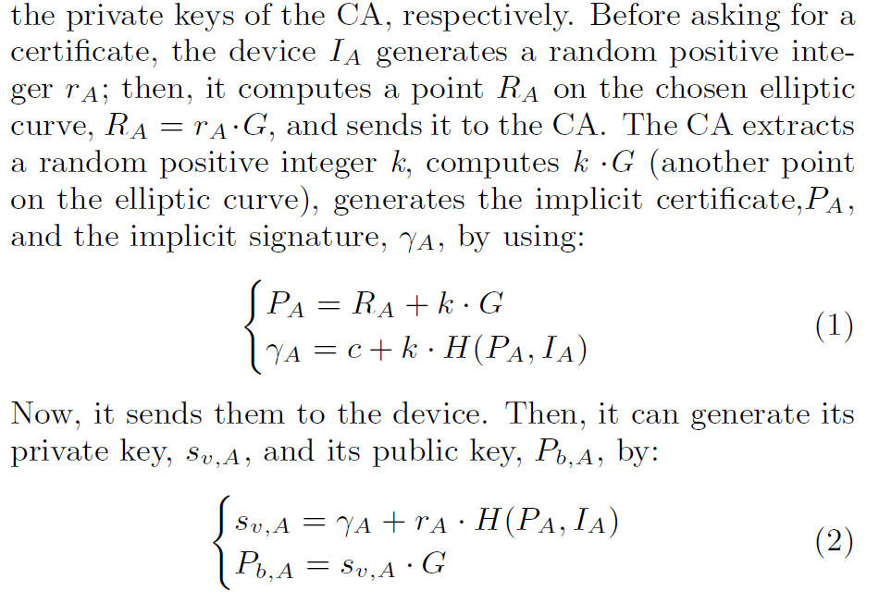
Initial registration
CA:
Private key → c
Public key → C = cG

Slide 5
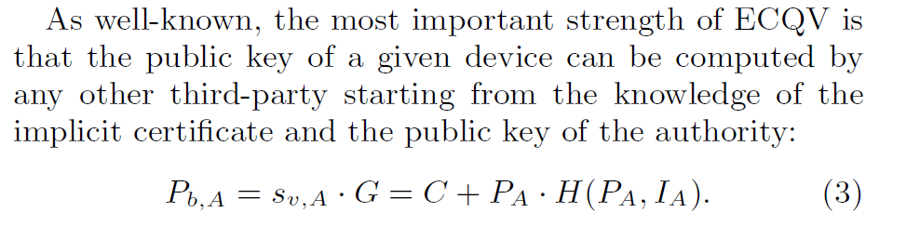
verification
In conclusion:
Unlike IBE PKG, no third party knows user private keys
Certificates: reduced to single (!) group point!!
Very low transport overhead compared to traditional certificates
O(40) bytes versus o(1000+) bytes
Application in low-resources IoT/wireless networks
See e.g., Sciancalepore, Capossele, Piro, Boggia, Bianchi, Key management protocol with implicit certificates for IoT systems. 2015 Workshop on IoT challenges in Mobile and Industrial Systems (pp. 37-42).
Used (at that time) only in ZigBee: Certificate Based Key Establishment (CBKE) protocol

